Slide 1
FATIGUE
Endurance Limit Modifying Factors

Slide 2
Cumulative Damage Log-Log Plot For Test Sample
σ – Cyclic Stress Level
n – Number of Cycles
S’_{f} – Fatigue Strength at N
N – Number of Cycles to Failure given S’_{f}
S’_{e} - Endurance Limit
S_{ut}- Ultimate Strength
0.9 S_{ut}
n₁
σ₁
Stress
σ₂
σ₃
S’_{e}
N₁
N₂
N₃
10³
10⁴
10⁵
10⁶
Cycles, N

Slide 3
Endurance Limit Modifying Factors
S_{e}=k_{a}k_{b}k_{c}k_{d}k_{e}k_{f}S’_{e}
k_{a}-surface factor
k_{b}-size factor
k_{c}-reliability factor
k_{d}-temperature factor
k_{e}-modifying factor for stress concentrations
k_{f}-miscellaneous effects factor

Slide 4
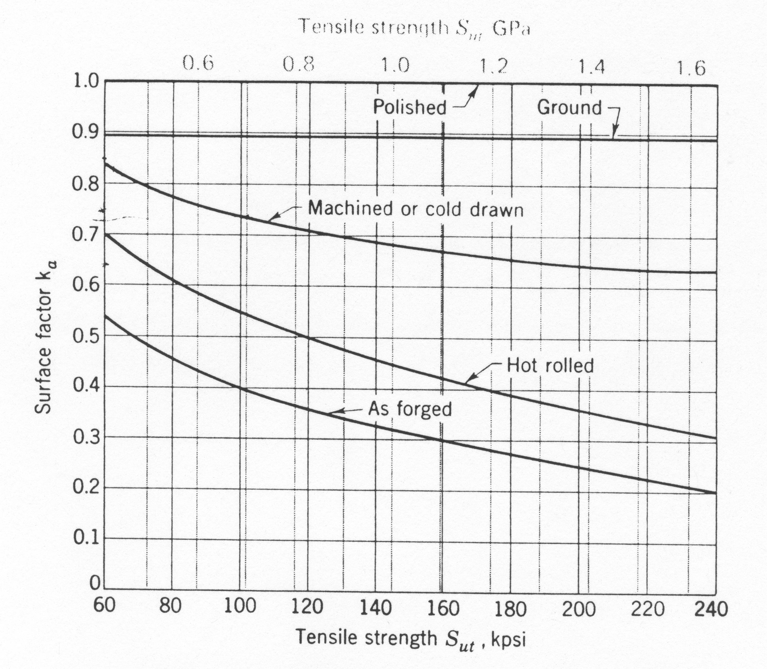
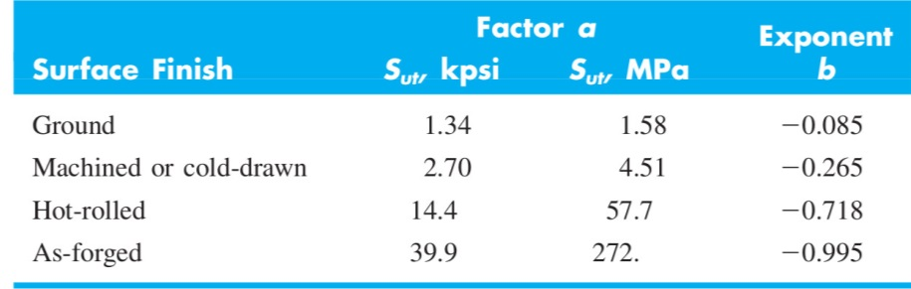
k_{a} – Surface factor

Slide 5
k_{b} – Size Effect
Rotating beam test specimen is 0.3 in in diameter
Large specimens
2in dia -> 10 to 25% reduction in S_{e}
Dia > 2in -> 25% reduction
For bending and torsion, k_{b}
d≤0.3in (7.6mm) -> k_{b}=1
0.3≤d≤2.0 -> k_{b}=0.85
d>2.0in -> k_{b}=0.75
For Axial loading, k_{b}=1

Slide 6
k_{c}- Loading Factor
Bending k_{c}=1
Axial k_{c}=0.85
Torsion k_{c}=0.59

Slide 7
k_{d} - Temperature
For steel
T < 160 °F -> k_{d}=1
T > 160 °F -> k_{d}=620/(460+T)

Slide 8
Stress Concentration
K_{t} – theoretical or geometric static stress concentration factor
K_{f} – fatigue strength reduction factor
(endurance limit of notch free specimen)/(endurance limit of notched specimens)
K_{f} =1+q(K_{t}-1), q-notch sensitivity
k_{e}=1/K_{f}

Slide 9
Stress Concentration
K_{t} – theoretical or geometric static stress concentration factor
K_{f} – fatigue strength reduction factor
Notch Sensitivity Factor

Slide 10
Neuber Constants,
Steel Loaded in Tension
Annealed Aluminum
Hardened Aluminum
S_{ut} (ksi) | 50 | 60 | 70 | 80 | 90 | 100 | 120 | 140 | 160 | 180 | 200 | 220 | 240
S_{ut} (Msi) | 345 | 414 | 483 | 552 | 621 | 689 | 827 | 965 | 1103 | 1241 | 1379 | 1517 | 1655
 | 0.130 | 0.108 | 0.093 | 0.080 | 0.070 | 0.062 | 0.049 | 0.039 | 0.031 | 0.024 | 0.018 | 0.013 | 0.009
S_{ut} (ksi) | 10 | 15 | 20 | 25 | 30 | 35 | 40 | 45
S_{ut} (Msi) | 69 | 103 | 138 | 172 | 207 | 241 | 276 | 310
 | 0.500 | 0.341 | 0.264 | 0.217 | 0.180 | 0.152 | 0.123 | 0.111
S_{ut} (ksi) | 15 | 20 | 30 | 40 | 50 | 60 | 70 | 80 | 90
S_{ut} (Msi) | 103 | 138 | 207 | 276 | 345 | 414 | 483 | 552 | 621
 | 0.175 | 0.380 | 0.278 | 0.219 | 0.186 | 0.162 | 0.144 | 0.131 | 0.122

Slide 11
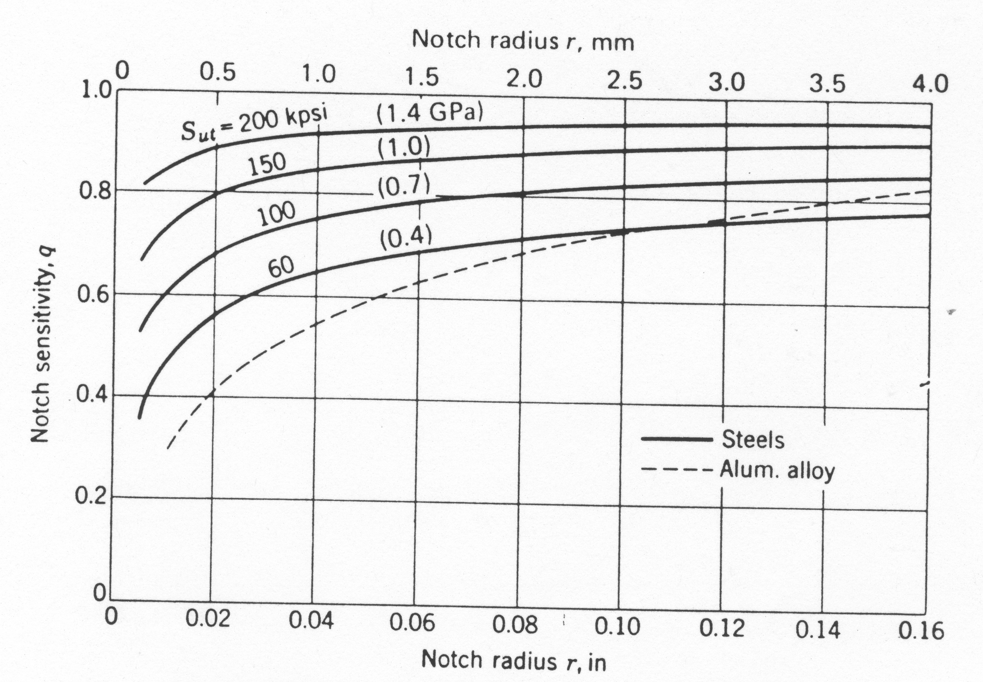
Notch Sensitivity Curves

Slide 12
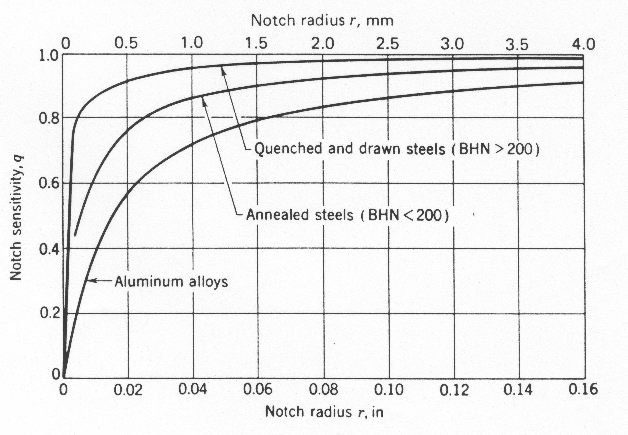
Additional Notch Sensitivity Curves

Slide 13
k_{e} - Reliability
Reliability, R | Standardized Variable, z_{R} | k_{c}
0.50 | 0 | 1.000
0.90 | 1.288 | 0.897
0.95 | 1.645 | 0.868
0.99 | 2.326 | 0.814
0.999 | 3.091 | 0.753
0.999 9 | 3.719 | 0.702
0.999 99 | 4.265 | 0.659
0.999 999 | 4.753 | 0.620
0.999 999 9 | 5.199 | 0.584
0.999 999 99 | 5.612 | 0.551
0.999 999 999 | 5.997 | 0.520

Slide 14
Example
1500 lb
3 in
4 in
A rotating shaft is supported by ball bearings at A and D and loaded by the non-rotating force F. Estimate the life of this part.
S_{ut}=103ksi
S_{yt}=72ksi
Shaft is drawn
UNS G10350 steel, drawn at 1000 C
Machined finish
10 in
5 in
0.5 in
0.5 in
A
B
C
D
1.18 in
1.25 in
1. 50 in
1.375 in
1.18 in
All Fillets 1/8 in Radius
M

